Slide 1
Notes:
1

Slide 2
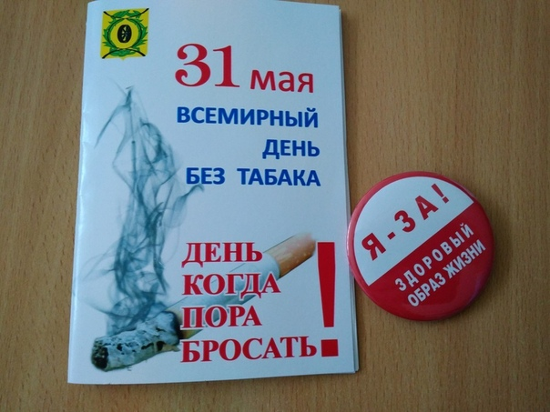

Slide 3
